Slide 1
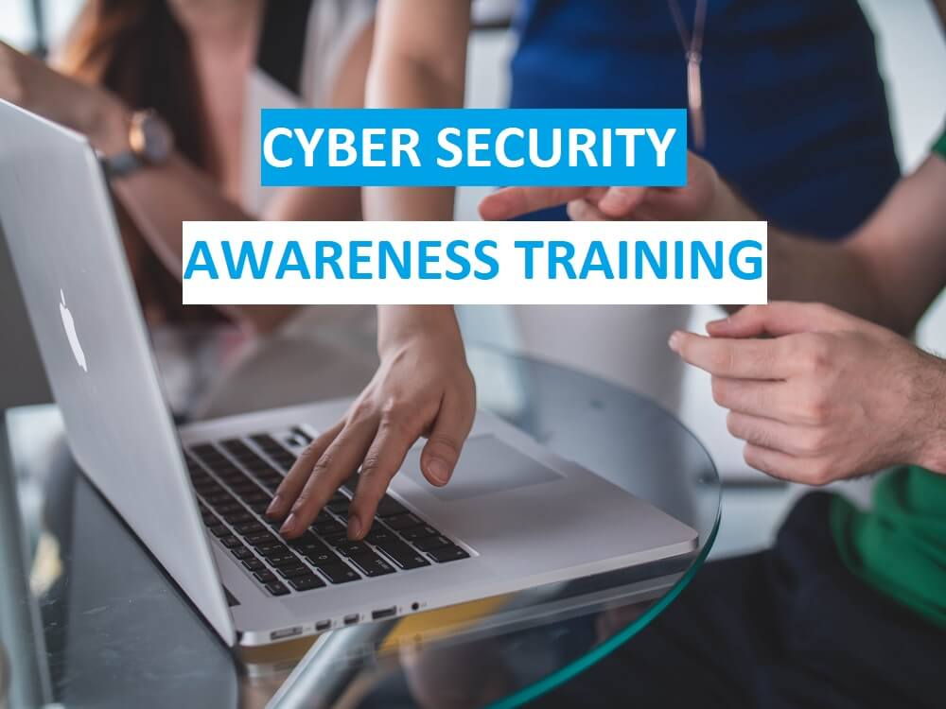
Cybersecurity Primer
Defense in Depth Approach

Slide 2
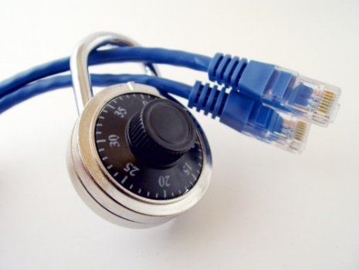
Importance of Cybersecurity
The internet allows an attacker to work from anywhere on the planet.
Risks caused by poor security knowledge and practice:
Identity Theft
Monetary Theft
Legal Ramifications (for yourself and your organization)
Sanctions or termination if policies are not followed
According to the SANS Institute, the top vectors for vulnerabilities available to a cyber criminal are:
Web Browser
IM Clients
Web Applications
Excessive User Rights

Slide 3
Cybersecurity is Safety
Security: We must protect our computers and data in the same way that we secure the doors to our homes.
Safety: We must behave in ways that protect us against risks and threats that come with technology.

Slide 4
User Awareness
Cyber-Criminals
System Administrators
Some scripts appear useful
to manage networks…
Cracker:
Computer-savvy
programmer creates
attack software
Posts to
Hacker Bulletin Board
SQL Injection
Buffer overflow
Password Crackers
Password Dictionaries
Successful attacks!
Crazyman broke into …
CoolCat penetrated…
Script Kiddies:
Unsophisticated computer users who know how to
execute programs
Downloads
Reports
Posts to
Criminals: Create & sell bots -> generate spam
Sell credit card numbers, etc…

Slide 5


Leading Threats
Viruses
Worms
Trojan Horses / Logic Bombs
Social Engineering
Rootkits
Botnets / Zombies

Slide 6
Viruses
A virus attaches itself to a program, file, or disk.
When the program is executed, the virus activates and replicates itself.
The virus may be benign or malignant but executes its payload at some point (often upon contact).
Viruses can cause computer crashes and loss of data.
In order to recover or prevent virus attacks:
Avoid potentially unreliable websites/emails.
System Restore.
Re-install operating system.
Use and maintain anti-virus software.
Program
A
Extra Code
infects
Program
B

Slide 7
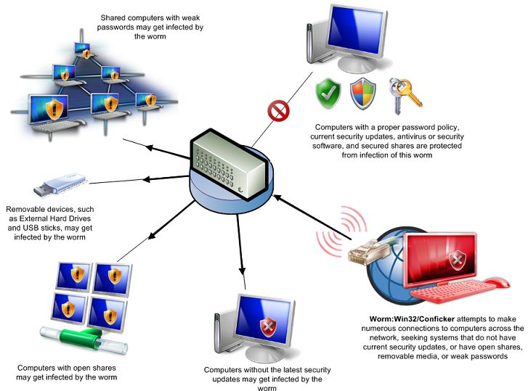
Worms
Independent program that replicates itself and sends copies from computer to computer across network connections.
Upon arrival, the worm may be activated to replicate.
To Joe
To Ann
To Bob
Email List:
Joe@gmail.com
Ann@yahoo.com
Bob@u.edu

Slide 8
Logic Bombs and Trojan Horses
Logic Bomb: Malware logic executes upon certain conditions. The program is often used for otherwise legitimate reasons.
Examples:
Software which malfunctions if maintenance fee is not paid.
Employee triggers a database erase when he is fired.
Trojan Horse: Masquerades as a benign program while quietly destroying data or damaging your system.
Download a game: It may be fun but contains hidden code that gathers personal information without your knowledge.

Slide 9


Social Engineering
manipulates people into performing actions or divulging confidential information. Similar to a confidence trick or simple fraud, the term applies to the use of deception to gain information, commit fraud, or access computer systems.
Email:
ABC Bank has
noticed a
problem with
your account…
Phone Call:
This is John, the System Administrator. What is your password?
In Person:
What ethnicity are you? Your mother’s maiden name?
I have come to repair your machine…
and have some lovely software patches!

Slide 10
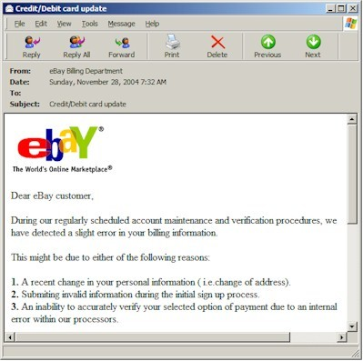
Phishing: Counterfeit Email
A seemingly trustworthy entity asks for sensitive information such as SSN, credit card numbers, login IDs or passwords via e-mail.

Slide 11
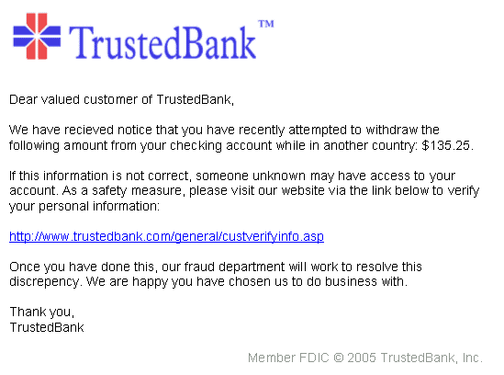
Pharming: Counterfeit Web Pages
Wiping over, but not clicking the link may reveal a different address.
Misspelled
With whom?
Copyright date is old
The link provided in the e-mail leads to a counterfeit webpage which collects important information and submits it to the owner.
The counterfeit web page looks like the real thing
Extracts account information

Slide 12
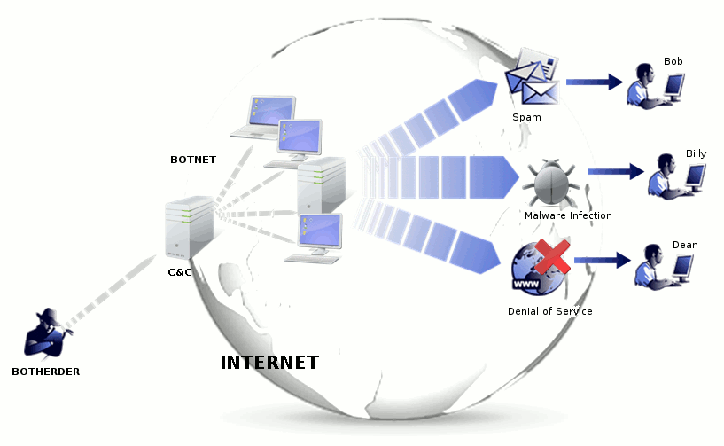
Botnet
A botnet is a number of compromised computers used to create and send spam or viruses or flood a network with messages as a denial-of-service attack.
The compromised computers are called zombies.

Slide 13
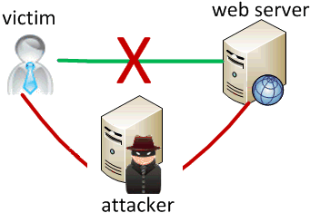
Man In The Middle Attack
An attacker pretends to be your final destination on the network. When a person tries to connect to a specific destination, an attacker can mislead him to a different service and pretend to be that network access point or server.
Notes:
.

Slide 14
Rootkit
Upon penetrating a computer, a hacker may install a collection of programs, called a rootkit.
May enable:
Easy access for the hacker (and others)into the enterprise
Keystroke logger
Eliminates evidence of break-in.
Modifies the operating system.
Backdoor entry
Keystroke Logger
Hidden user

Slide 15
Password Cracking
Dictionary Attack and Brute Force: How Much Time It Will Take To Crack
Pattern | Calculation | Result | Time to Guess (2.6x10¹⁸ tries/month)
Personal Info: interests, relatives |  | 20 | Manual 5 minutes
Social Engineering |  | 1 | Manual 2 minutes
American Dictionary |  | 80,000 | < 1 second
4 chars: lower case alpha | 26⁴ | 5x10⁵
8 chars: lower case alpha | 26⁸ | 2x10¹¹
8 chars: alpha | 52⁸ | 5x10¹³
8 chars: alphanumeric | 62⁸ | 2x10¹⁴ | 3.4 min.
8 chars alphanumeric +10 | 72⁸ | 7x10¹⁴ | 12 min.
8 chars: all keyboard | 95⁸ | 7x10¹⁵ | 2 hours
12 chars: alphanumeric | 62¹² | 3x10²¹ | 96 years
12 chars: alphanumeric + 10 | 72¹² | 2x10²² | 500 years
12 chars: all keyboard | 95¹² | 5x10²³
16 chars: alphanumeric | 62¹⁶ | 5x10²⁸

Slide 16

Identifying Security Compromises
Indicators:
Antivirus software detects a problem.
Disk space disappears unexpectedly.
Pop-ups suddenly appear, sometimes selling security software.
Files or transactions appear that should not be there.
The computer slows down to a crawl.
Unusual messages, sounds, or displays on your monitor.
Stolen laptop: 1 stolen every 53 seconds; 97% never recovered.
The mouse pointer moves by itself.
The computer spontaneously shuts down or reboots.
Often unrecognized or ignored problems.

Slide 17
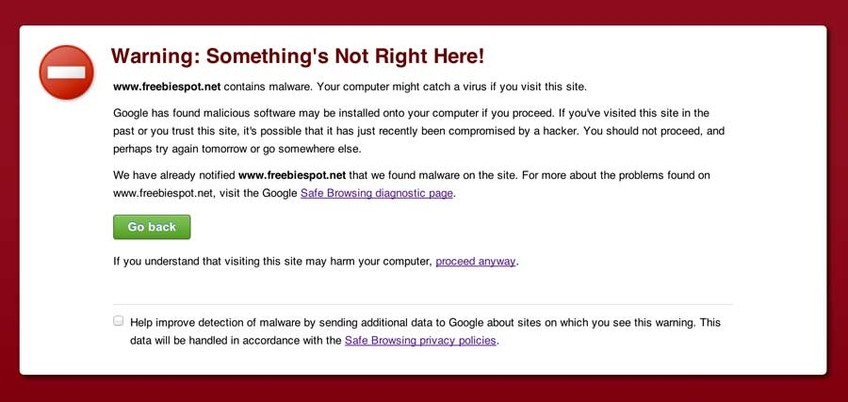
Malware detection
Spyware Indicators:
Changes to your browser homepage/start page.
Ending up on a strange site when conducting a search.
System-based firewall is turned off automatically.
Lots of network activity while not particularly active.
Excessive pop-up windows.
New icons, programs, favorites which you did not add.
Frequent firewall alerts about unknown programs when trying to access the Internet.
Poor system performance.

Slide 18
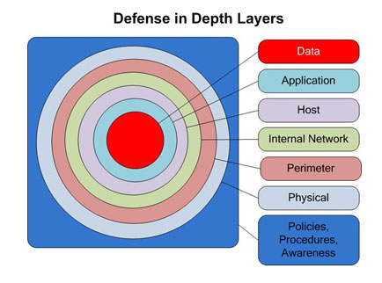
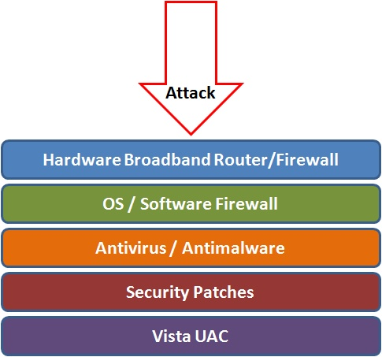
Best Practices to avoid these threats
Defense in depth uses multiple layers of defense to address technical, personnel and operational issues.
User Account Controls

Slide 19
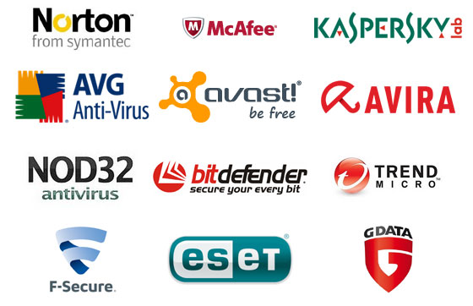
Anti-virus and Anti-spyware Software
Anti-virus software detects certain types of malware and can destroy it before any damage is done.
Install and maintain anti-virus and anti-spyware software.
Be sure to keep anti-virus software updated.
Many free and commercial options exist.
Contact your Technology Support Professional for assistance.

Slide 20
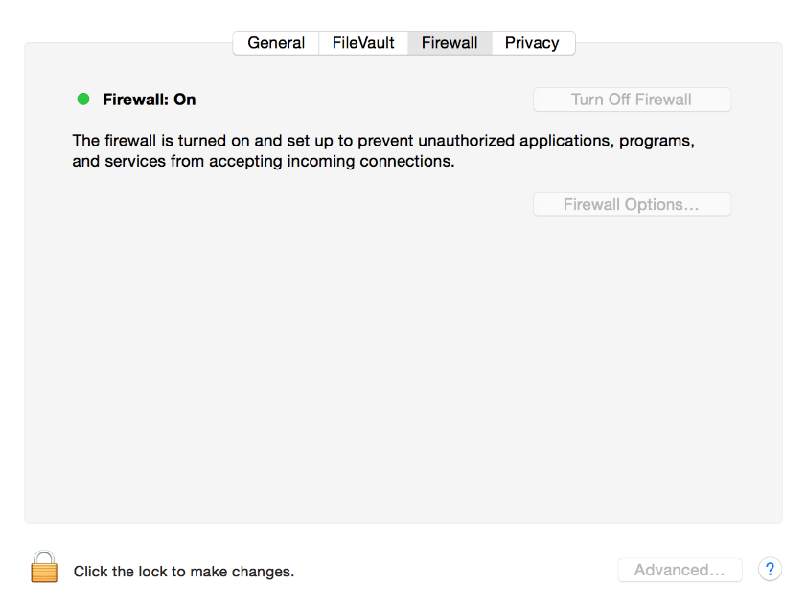
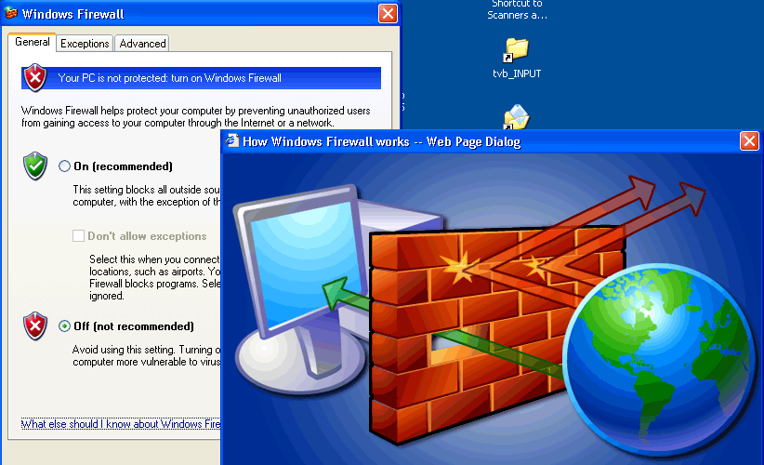
Host-based Firewalls
A firewall acts as a barrier between your computer/private network and the internet. Hackers may use the internet to find, use, and install applications on your computer. A firewall prevents many hacker connections to your computer.
Firewalls filter network packets that enter or leave your computer

Slide 21
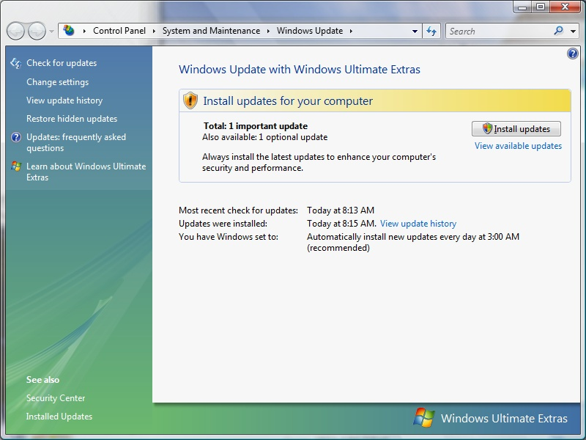
Protect your Operating System
Microsoft regularly issues patches or updates to solve security problems in their software. If these are not applied, it leaves your computer vulnerable to hackers.
The Windows Update feature built into Windows can be set up to automatically download and install updates.
Avoid logging in as administrator
Apple provides regular updates to its operating system and software applications.
Apply Apple updates using the App Store application.

Slide 22
Use Strong Passwords
Make passwords easy to remember but hard to guess
nOps standards:
Be at least ten characters in length
Must contain characters from at least two of the following four types of characters:
English upper case (A-Z)
English lower case (a-z)
Numbers (0-9)
Non-alphanumeric special characters ($, !, %, ^, …)
Must not contain the user’s name or part of the user’s name
Must not contain easily accessible or guessable personal information about the user or user’s family, such as birthdays, children’s names, addresses, etc.

Slide 23
Creating Strong Passwords
A familiar quote can be a good start:
Using the organization standard as a guide, choose the first character of each word:
LIASMWTFOS
Now add complexity the standard requires:
L1A$mwTF0S (10 characters, 2 numerals, 1 symbol, mixed English case: password satisfies all 4 types).
Or be more creative!
“LOVE IS A SMOKE MADE WITH THE FUME OF SIGHS”
William Shakespeare

Slide 24

Password Guidelines
Never use admin, root, administrator, or a default account or password for administrative access.
A good password is:
Private: Used by only one person.
Secret: It is not stored in clear text anywhere,
including on Post-It® notes!
Easily Remembered: No need to write it down.
Contains the complexity required by your organization.
Not easy to guess by a person or a program in a reasonable time, such as several weeks.
Changed regularly: Follow organization standards.
Avoid shoulder surfers and enter your credentials carefully! If a password is entered in the username field, those attempts usually appear in system logs.

Slide 25

Avoid Social Engineering and Malicious Software
Do not open email attachments unless you are expecting the email with the attachment, and you trust the sender.
Do not click on links in emails unless you are absolutely sure of their validity.
Only visit and/or download software from web pages you trust.

Slide 26

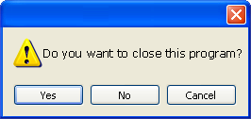
Avoid Stupid Hacker Tricks
Be sure to have a good firewall or pop-up blocker installed.
Pop-up blockers do not always block ALL pop-ups so always close a pop-up window using the ‘X’ in the upper corner.
Never click “yes,” “accept” or even “cancel.”
Infected USB drives are often left unattended by hackers in public places.

Slide 27
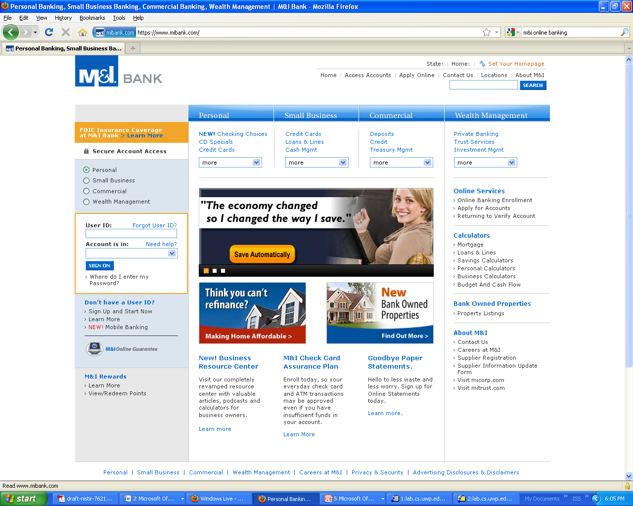
Secure Business Transactions
Always use secure browser to do online activities.
Frequently delete temp files, cookies, history, saved passwords etc.
https://
Symbol indicating
enhanced security

Slide 28

Backup Important Information
No security measure is 100% reliable.
Even the best hardware fails.
What information is important to you?
Is your backup:
Recent?
Off-site & Secure?
Process Documented?
Encrypted?
Tested?

Slide 29
Cyber Incident Reporting
If you suspect a cybersecurity incident, notify your organization’s help desk or the nOps help desk immediately. Be prepared to supply the details you know and contact information.
Do not attempt to investigate or remediate the incident on your own.
Inform other users of the system and instruct them to stop work immediately.
Unless instructed, do not power down the machine.
Unless instructed, do not remove the system from the network.
The cybersecurity incident response team will contact you as soon as possible to gather additional information.
Each nOps department is required to have a specific plan to handle cybersecurity incidents. Refer to local policies, standards and guidelines for specific information.

Slide 30
Fraud
Organizations lose 5-6% of revenue annually due to internal fraud = $652 Billion in U.S. (2006)
Average scheme lasts 18 months, costs $159,000
25% costs exceed $1M
Smaller companies suffer greater average dollar losses than large companies

Slide 31
Fraud Discovery
Tips are the most common way fraud is discovered.
Tips come from:
Employee/Coworkers 64%,
Anonymous 18%,
Customer 11%,
Vendor 7%

Slide 32
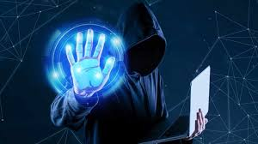
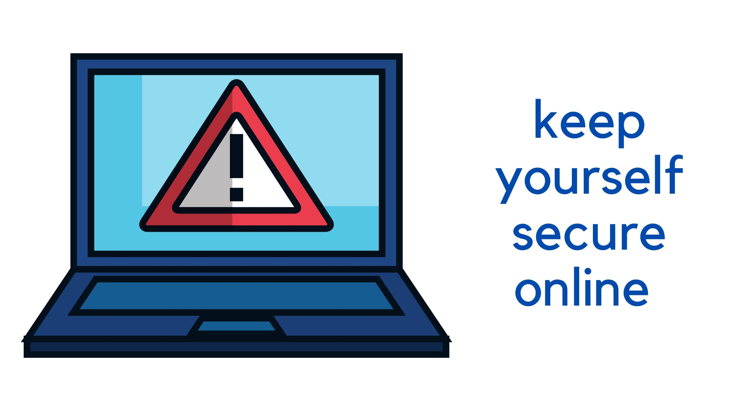
Thank you

